Slide 1
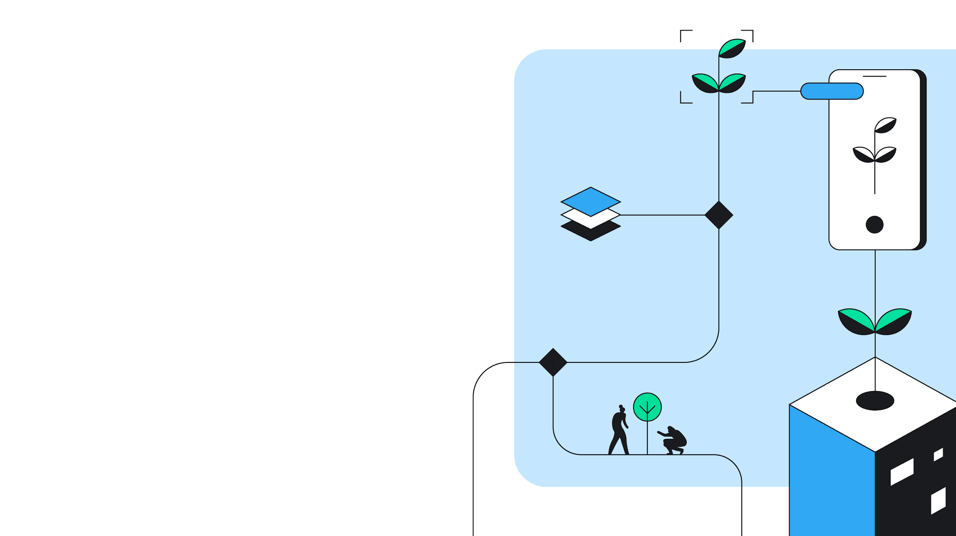

“Impact the Future”
Women Techmakers IWD Baku 2024
#IWDBaku2024
#IWD24Baku
#WTMIWD, #WTMImpactTheFuture, #IWD24, #WomenInTech

Slide 2
1. About Me
2. About WTM IWD 2024
3. IWD Event Planning
4. Getting Started - Our All Events
5. Being WTM Speaker, Member and Ambassador
6. Photos, Badges, community
Table
of
my
speech

Slide 3
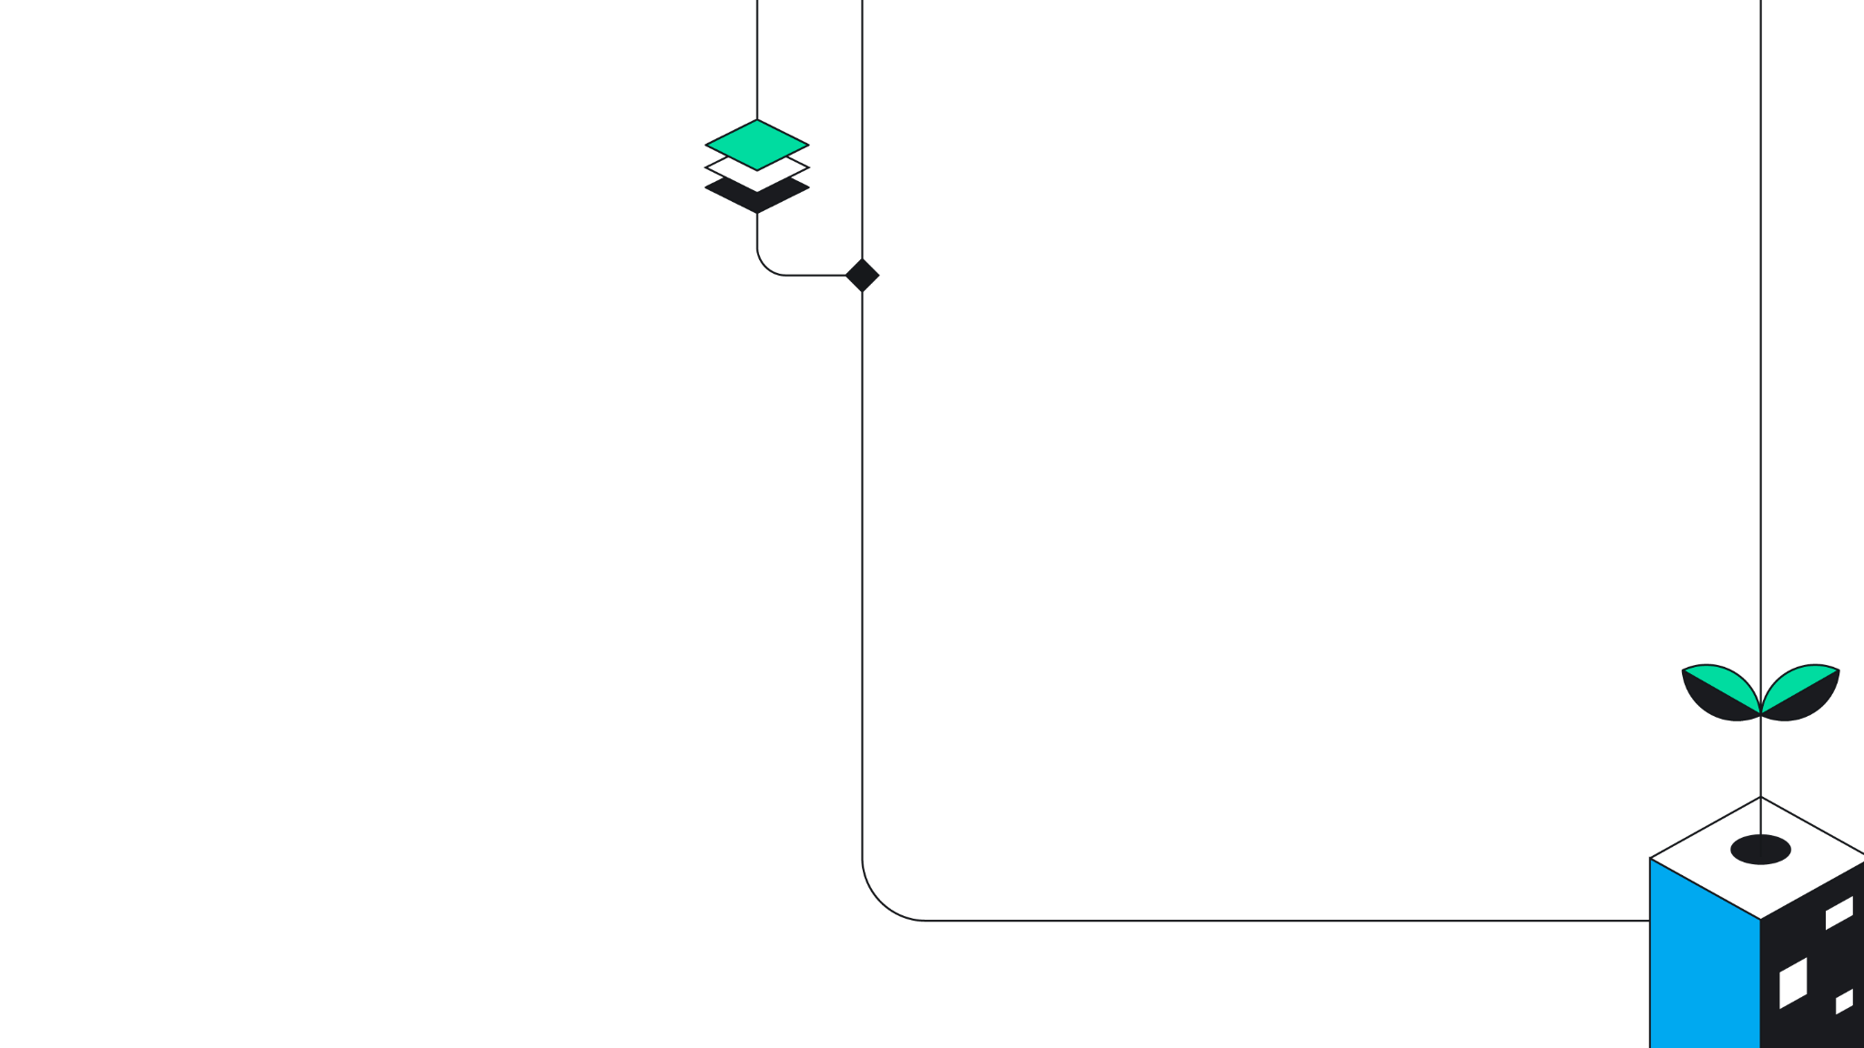
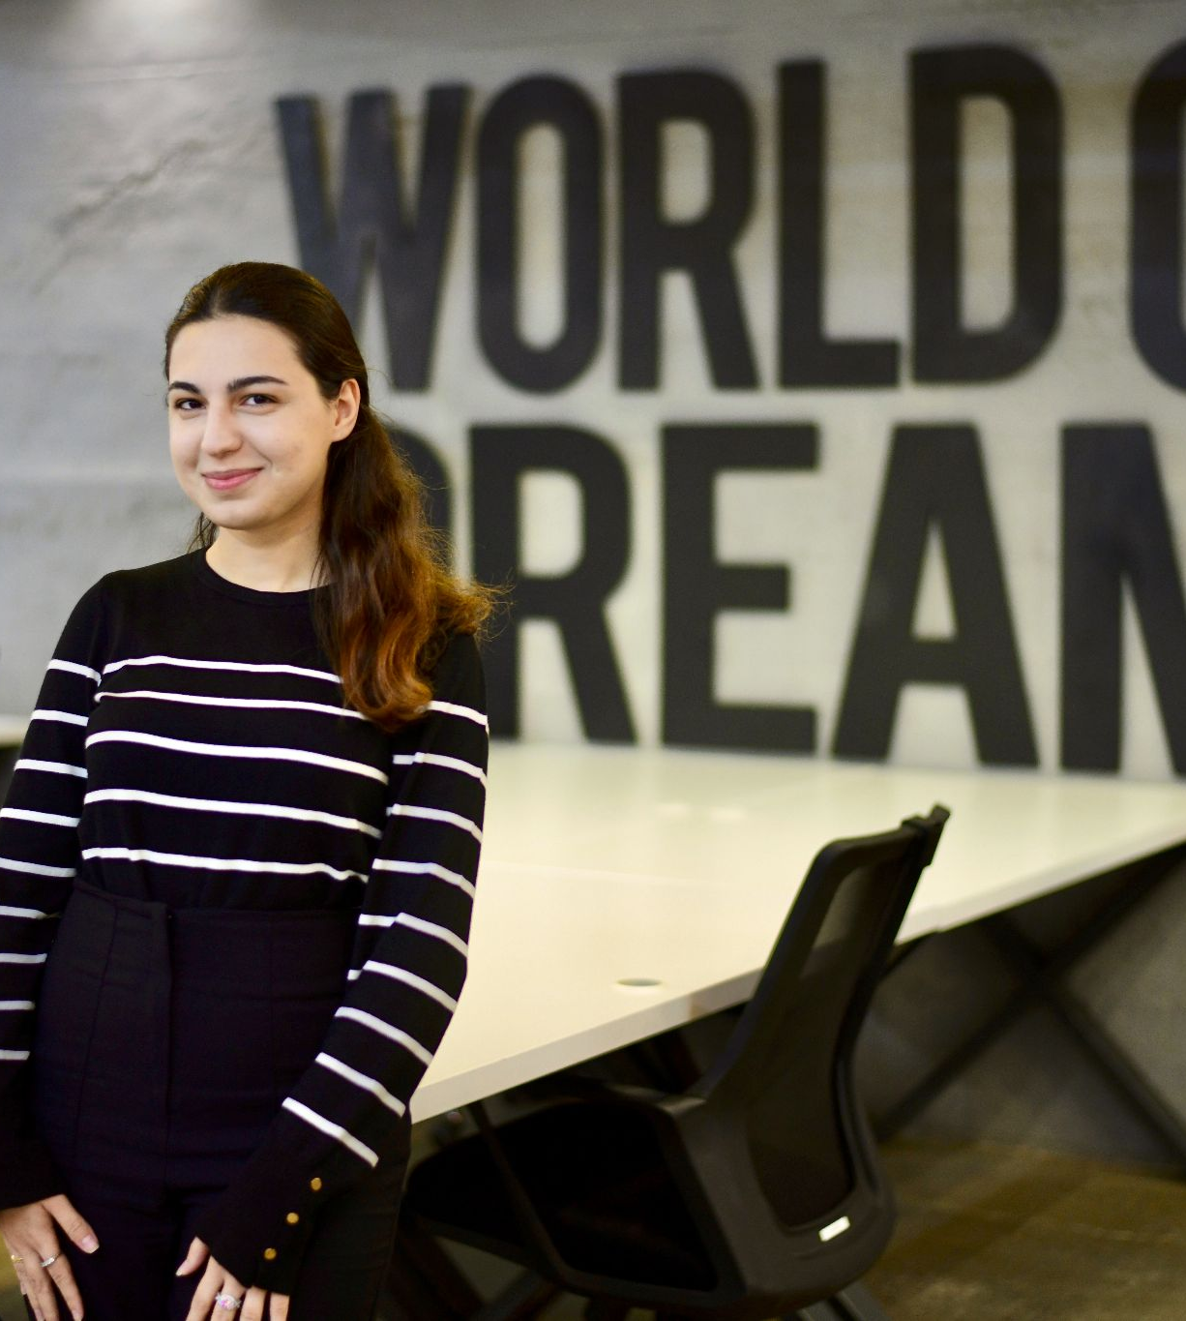


Lala Ibadullayeva
WTM Ambassador

Slide 4
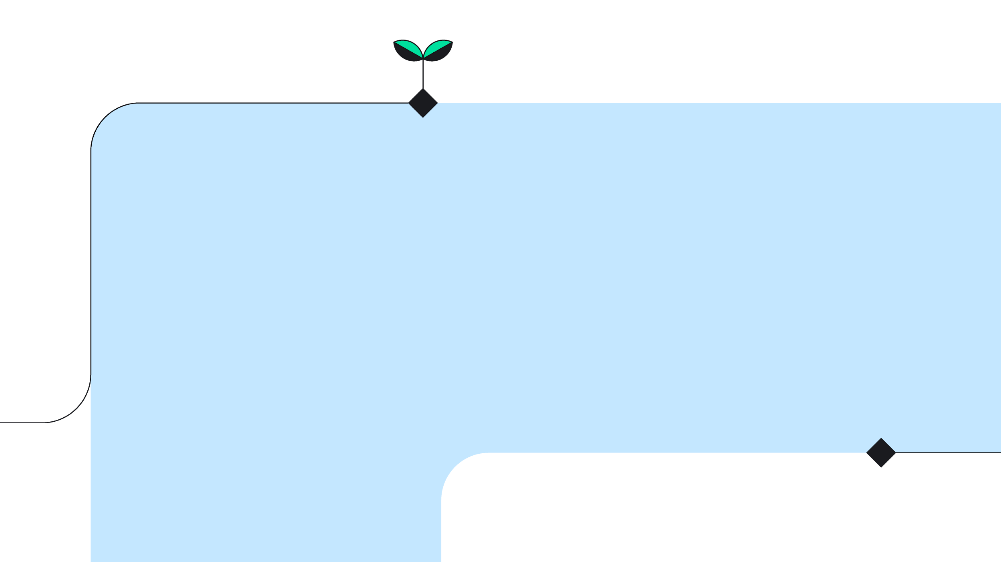
02. About Women Techmakers’ International Women’s Day

Slide 5

About the theme: “Impact the Future”
What are you working on that will make a difference in the world? How are you using your skills and talents to create a better future for all? Ultimately, we can dream big and be bold when we “Impact the Future”
How will you “Impact the Future” this International Women’s Day?

Slide 6
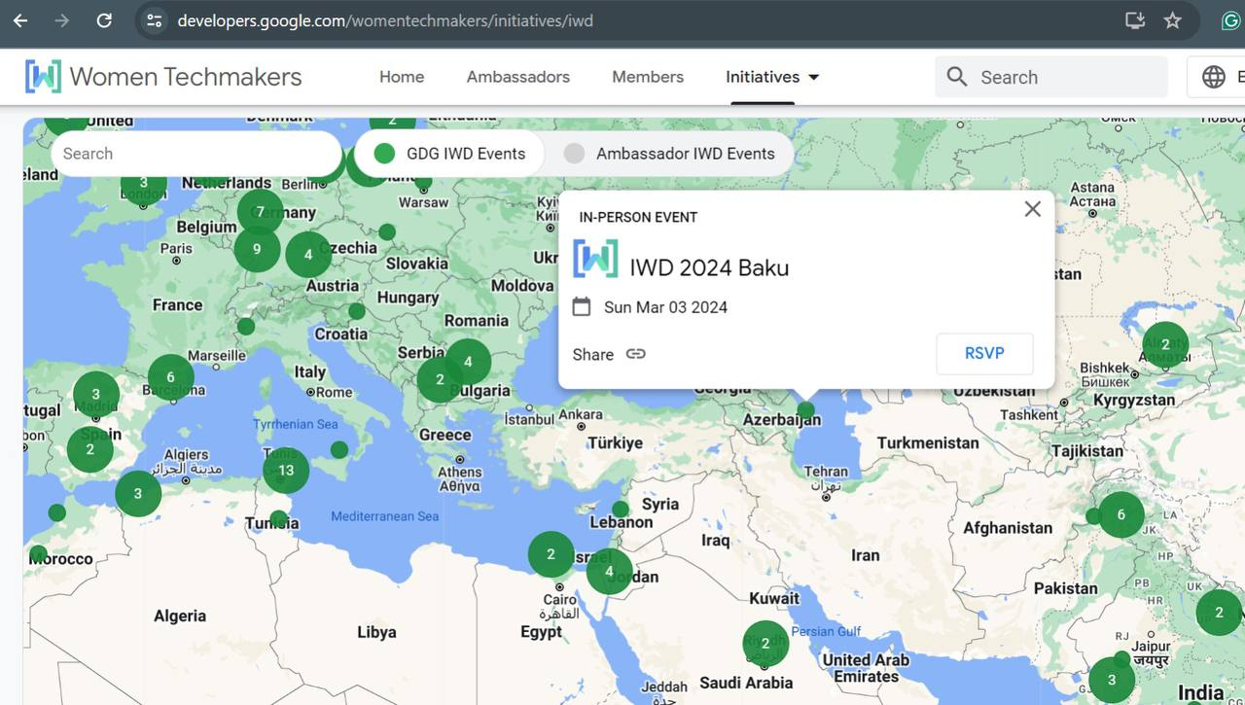
The great news :
Women Techmakers IWD site
Notes:
https://developers.google.com/womentechmakers/initiatives/iwd#find-event
https://bit.ly/WTMIWD24

Slide 7

Our questions :
What is WTM International Women’s Day?
How do Ambassadors participate in IWD?
IWD Swags <3
WTM Events on Advocu
International Women’s Day (IWD) occurs on March 8th every year. It marks a moment to celebrate and provide visibility for the incredible contributions of women around the world and is a call to action for accelerating gender parity.
Notes:
2023-cü ildə “Dare To Be” IWD kampaniyamız dünya üzrə 200k+ iştirakçıya çatdı!

Slide 8
03
IWD Event planning

Slide 9
IWD Dates
Group chats and meetings (for all of the details)
Sending Posts to Social Media
Making plan
Talking with speakers
Sending participation Mails
Registration
January 2024 February 2024
March
Searching speakers
Making great posts and doing again meeting for the all details
Sending Mails to the Google for the support
The WTM IWD Day

Slide 10
04. Getting started
(Welcome to the our past events ^_^)

Slide 11

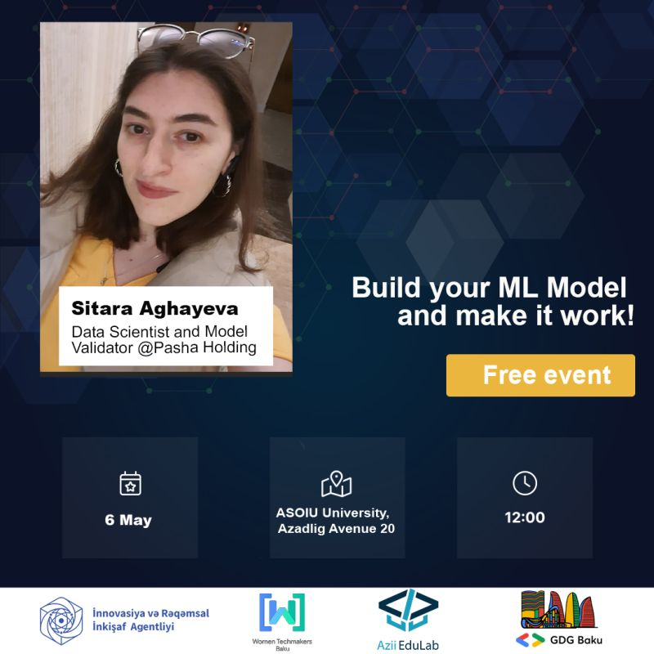






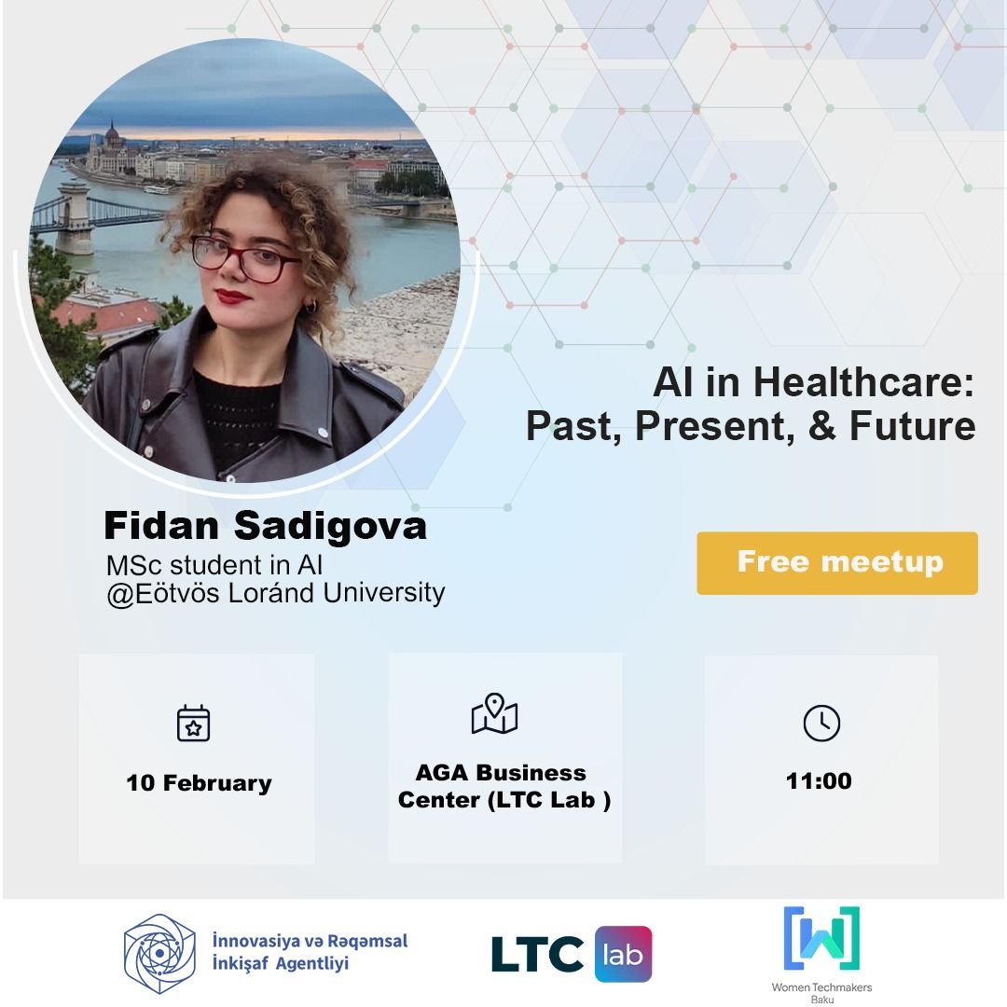


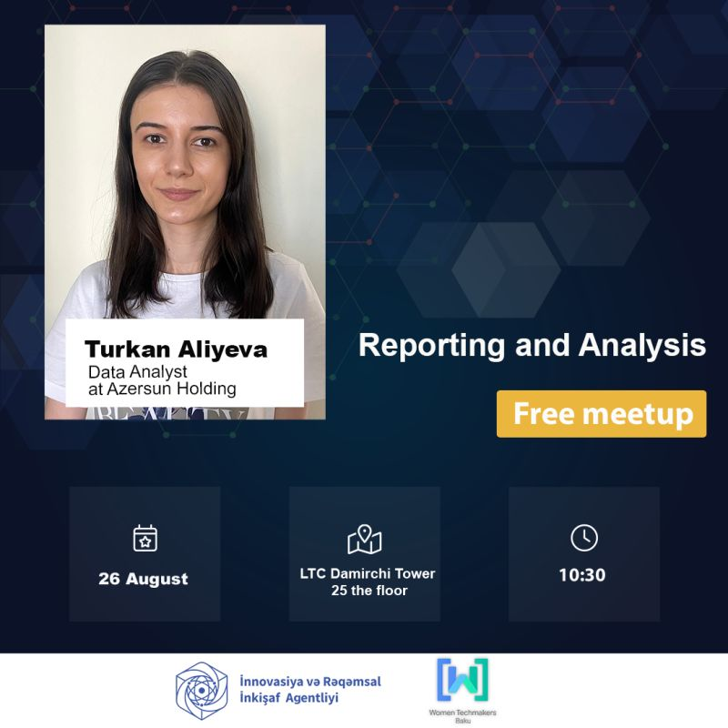




Slide 12
05. Being a
WTM Speaker, Member and Ambassador
Notes:
WTM membership link: https://bit.ly/membersiwd24

Slide 13
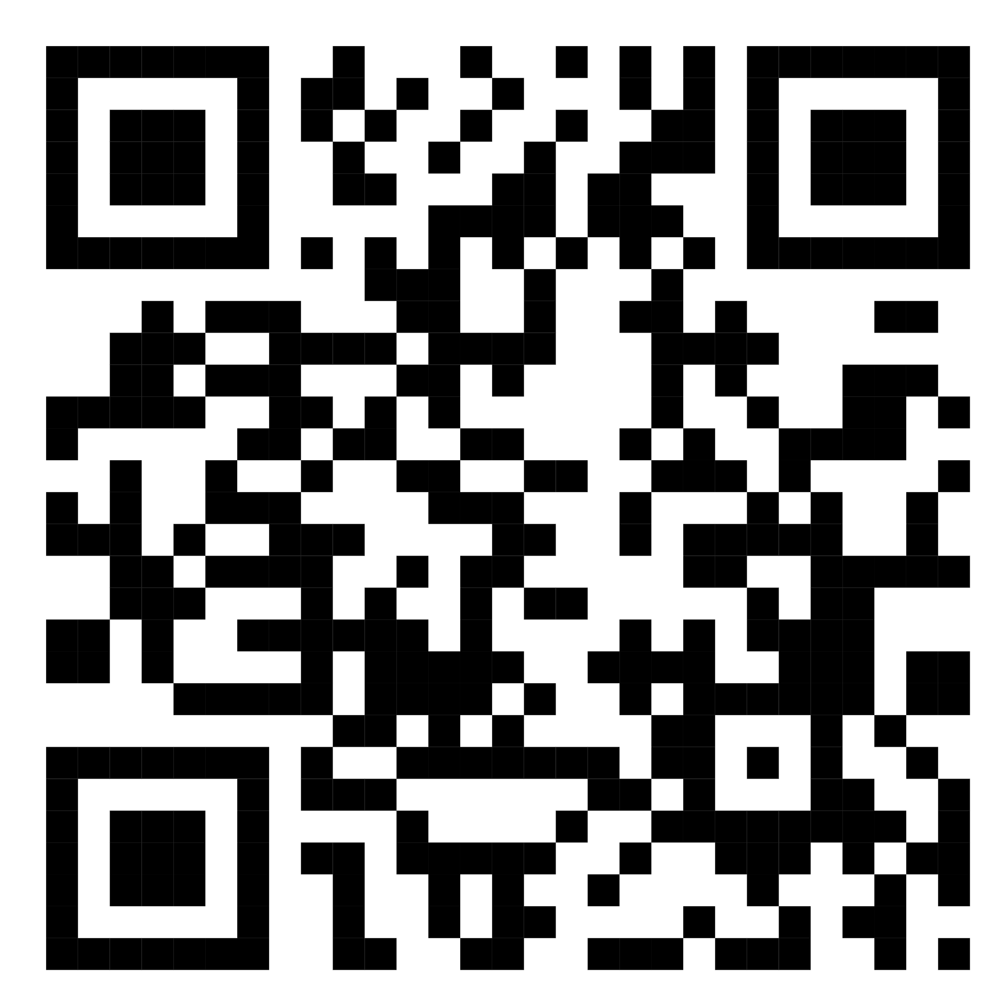
Being a WTM Speaker :

Slide 14

Being a WTM Member and Ambassador :
https://bit.ly/membersiwd24

Slide 15
06. IWD Photos, Badge, Community

Slide 16

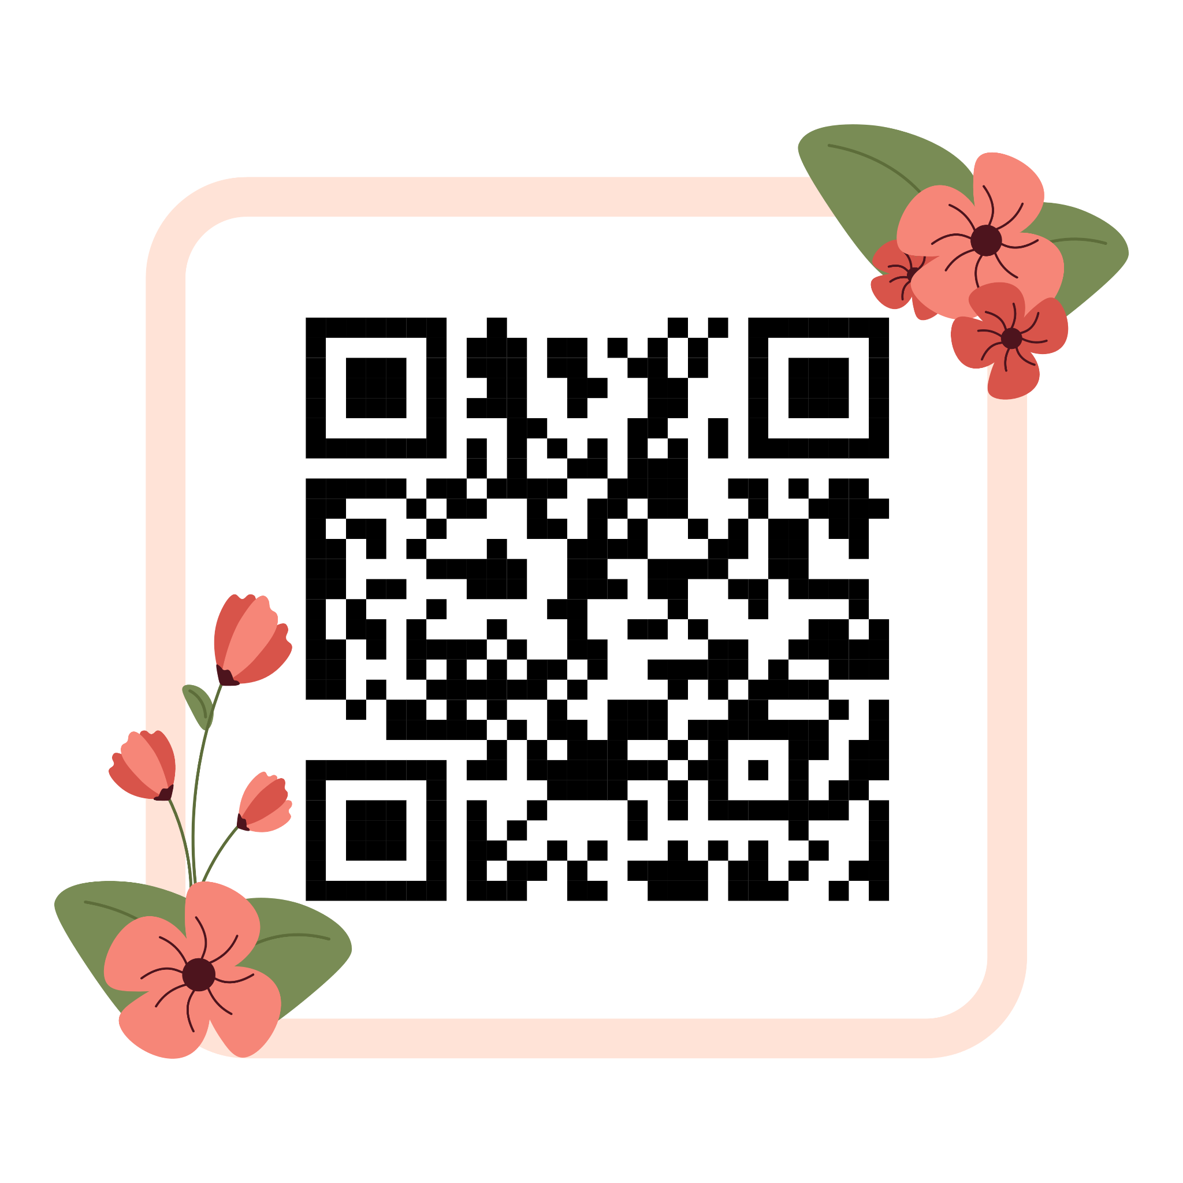
Photos

Slide 17
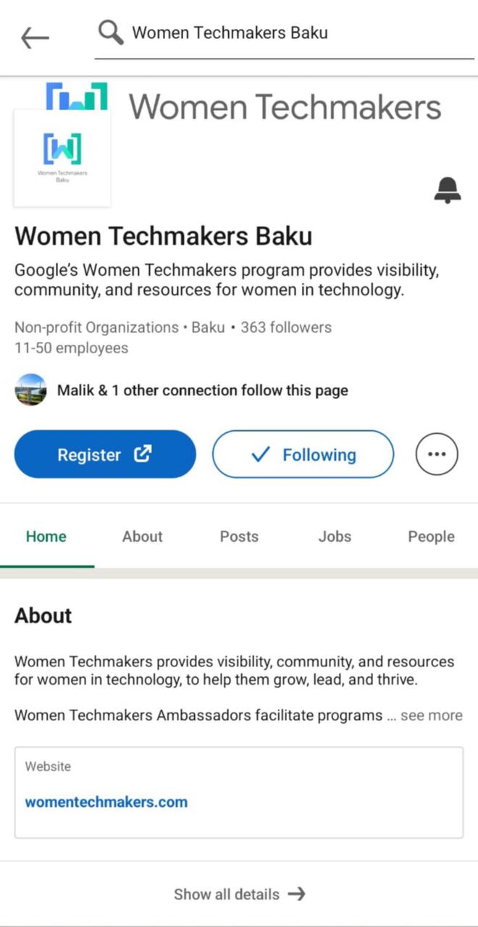
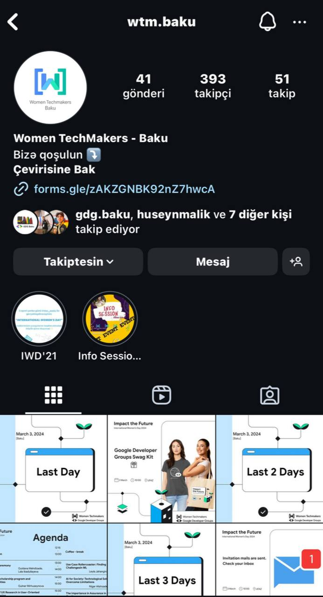
Social Media

Slide 18
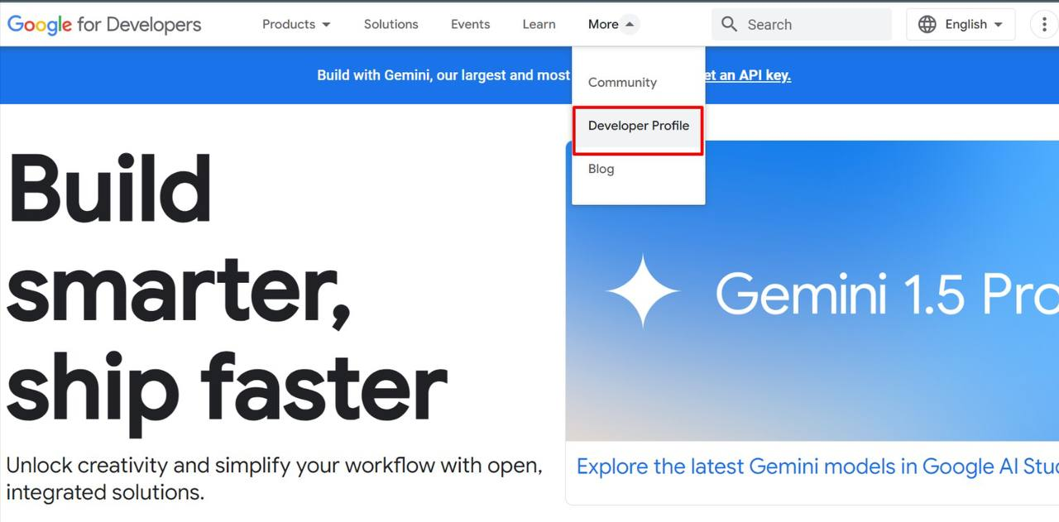
Notes:
https://developers.google.com/womentechmakers/initiatives/iwd#find-event
https://bit.ly/WTMIWD24

Slide 19
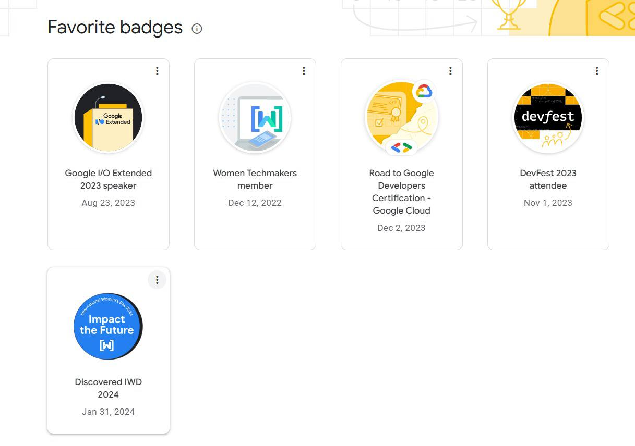
Notes:
https://developers.google.com/womentechmakers/initiatives/iwd#find-event
https://bit.ly/WTMIWD24

Slide 20
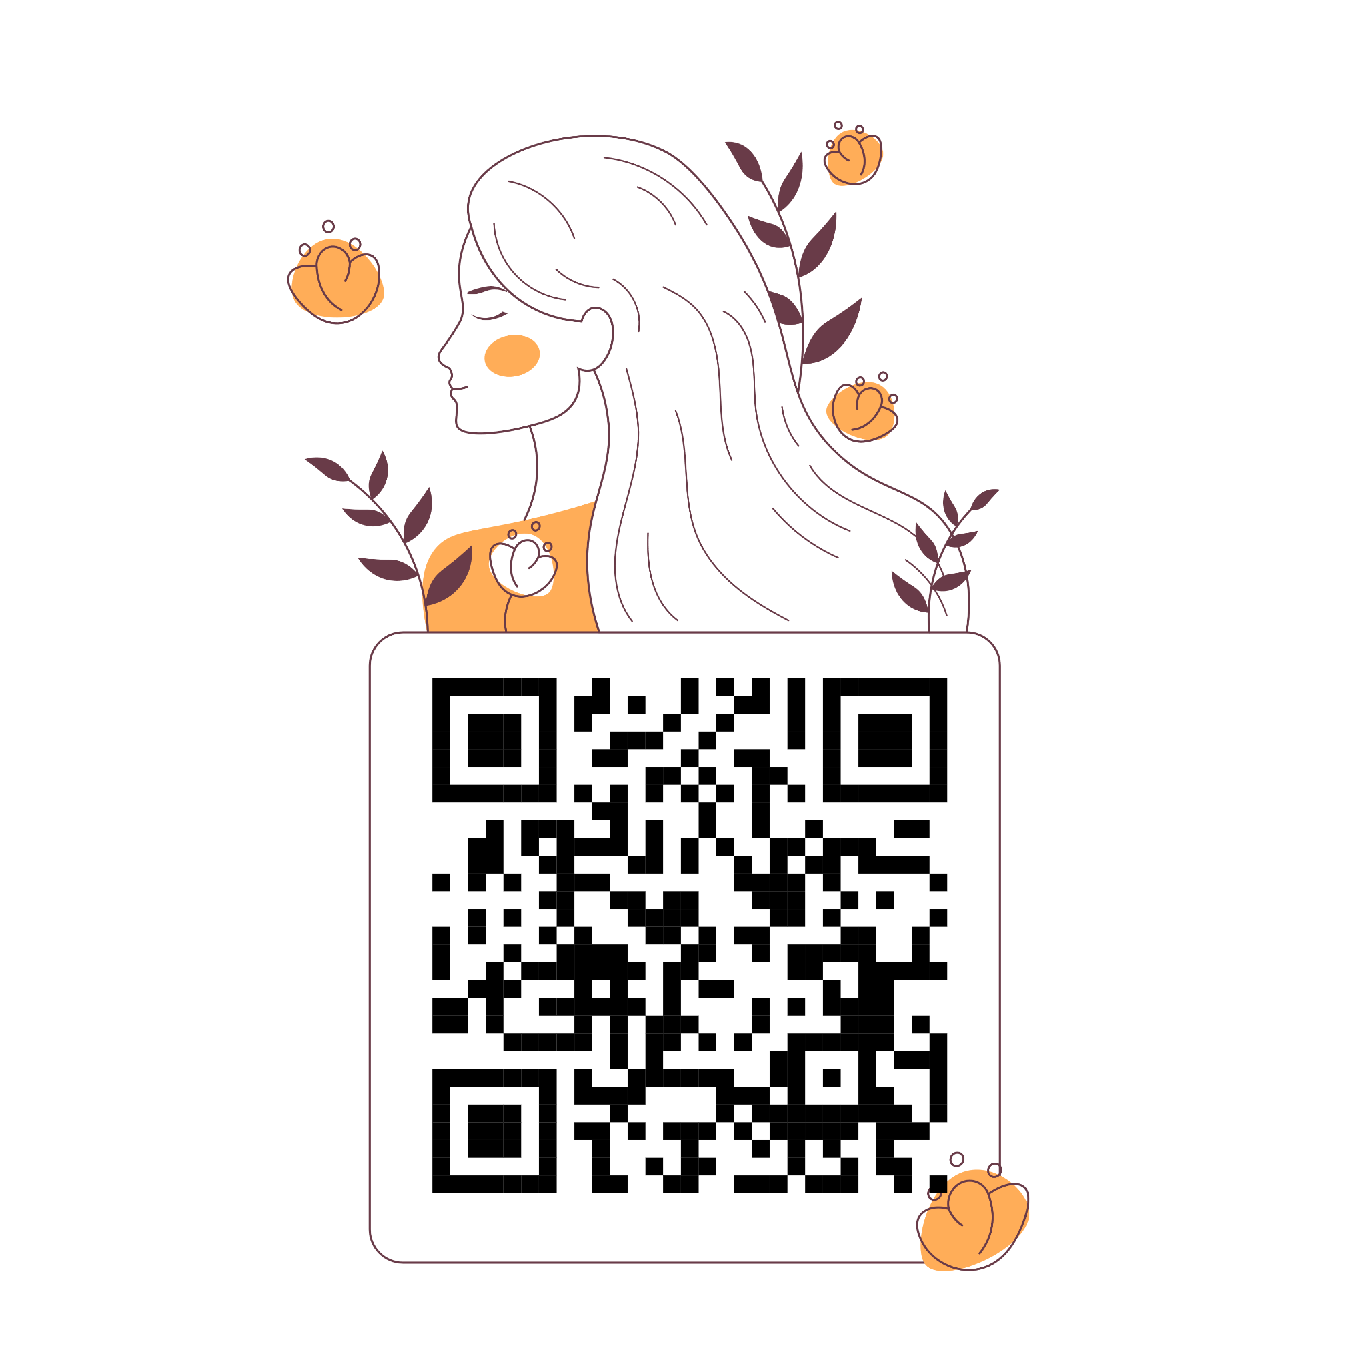
IWD`24 Badge :

Slide 21
Thank you for your attention 🥰

